Slide 1
Licensing in China
LES Annual Meeting – Chicago 2017
Erick.Robinson@BeijingEastIP.com
US Mobile: (713) 498-6047

Slide 2
Erick Robinson
U.S. patent attorney based in Beijing: 17 years of experience in litigating and licensing patents worldwide for law firms and companies.
Erick Robinson
BA Physics/Computer Science, Pomona College
JD, University of Texas
MBA, Indiana University (2018)
IAM Strategy 300, The World’s Leading IP Strategists 2015-17
USPTO, Registered Patent Attorney
Mobile (USA): +1 713 498 6047
WeChat: erickrobinson
Email: Erick.Robinson@BeijingEastIP.com

Slide 3
Why China?
High win rate (75% - 95%)
Foreign plaintiffs win more than Chinese plaintiffs (but must do their homework)
Virtually guaranteed injunctions (99%)
Short time from filing to trial/judgment (6-14 months)
Sparse discovery = Low cost
Validity challenges are often not complete until after judgment (and injunction)
Dominant Chinese market for sales (largest worldwide for many electronics) and manufacturing (largest worldwide)
Specialized IP Courts and judges that take pride in their skill and fairness (no discrimination against NPEs)
Although a civil law system, judges seek out and respect prior decisions
Government has demanded that the courts be fair and create a strong enforcement system
Forum shopping available (a Best Buy in Longview…)
Pre-trial asset freeze available – freezing bank accounts, inventory a useful negotiating tactic
System for blocking goods due for export at Customs is well developed

Slide 4
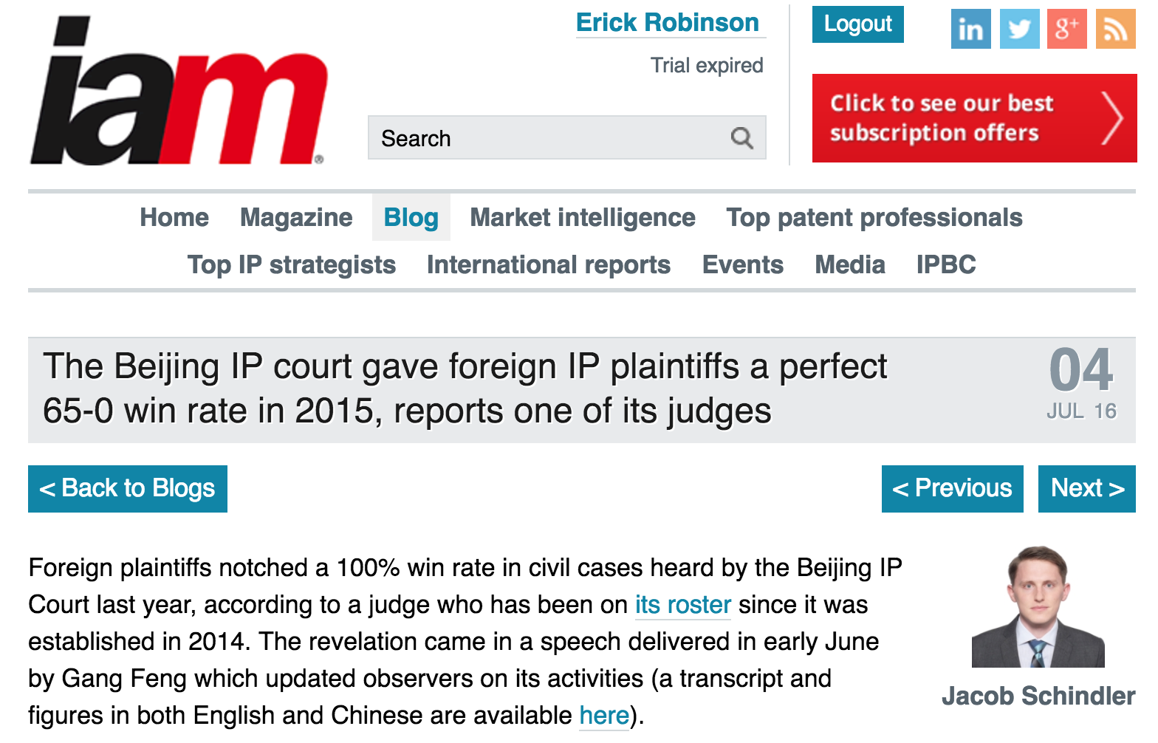
China Welcomes Foreign Plaintiffs
http://www.iam-media.com/blog/Detail.aspx?g=8dc59dc8-6405-4b86-b241-27e89afc6089
One study that suggests foreign companies are now better able to protect their intellectual property was done by the London-based law firm Rouse. In analyzing 346 first-instance patent infringement cases initiated by foreign plaintiffs between 2006 and 2014, the firm, which runs the Beijing-based intellectual properties litigation database CIELA, found an 82 percent win rate (282 cases).
In a separate study, Beijing-based Kangxin Intellectual Property Agency Co. Ltd., an affiliate of law firm Kangxin Partners, found an 89 percent win rate in 114 first-instance patent cases initiated by foreign plaintiffs (102 cases won) between 2013 and 2015.
http://www.corpcounsel.com/id=1202764600143/IP-Litigation-in-China-Foreign-Companies-Still-Face-Challenges?mcode=0&curindex=0&curpage=ALL

Slide 5
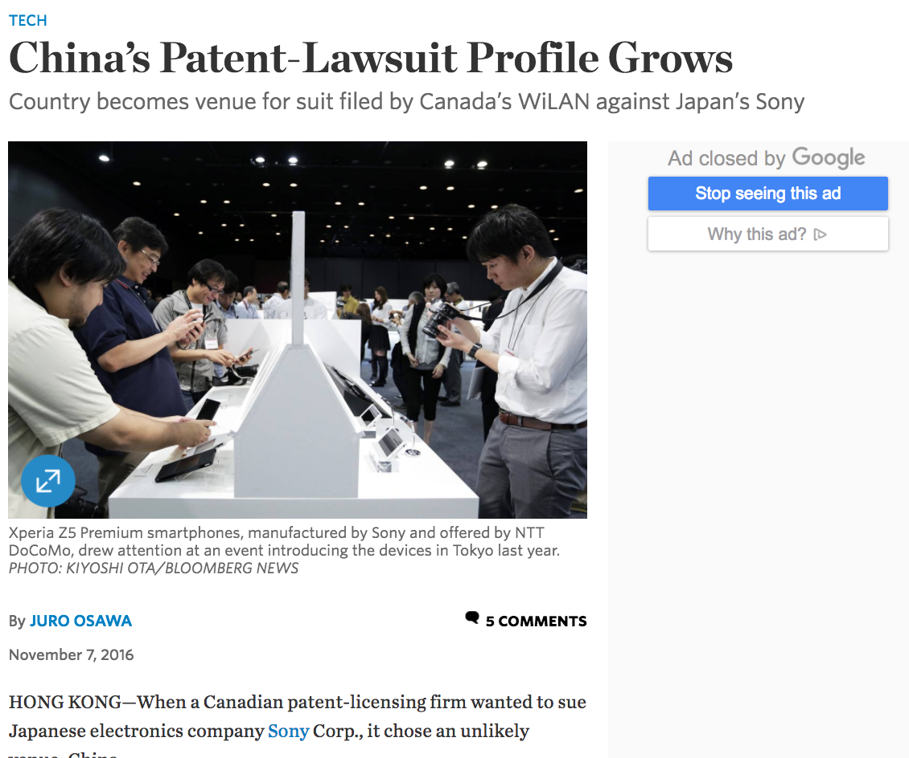
China Has Become a Top Forum for Patent Enforcement

Slide 6
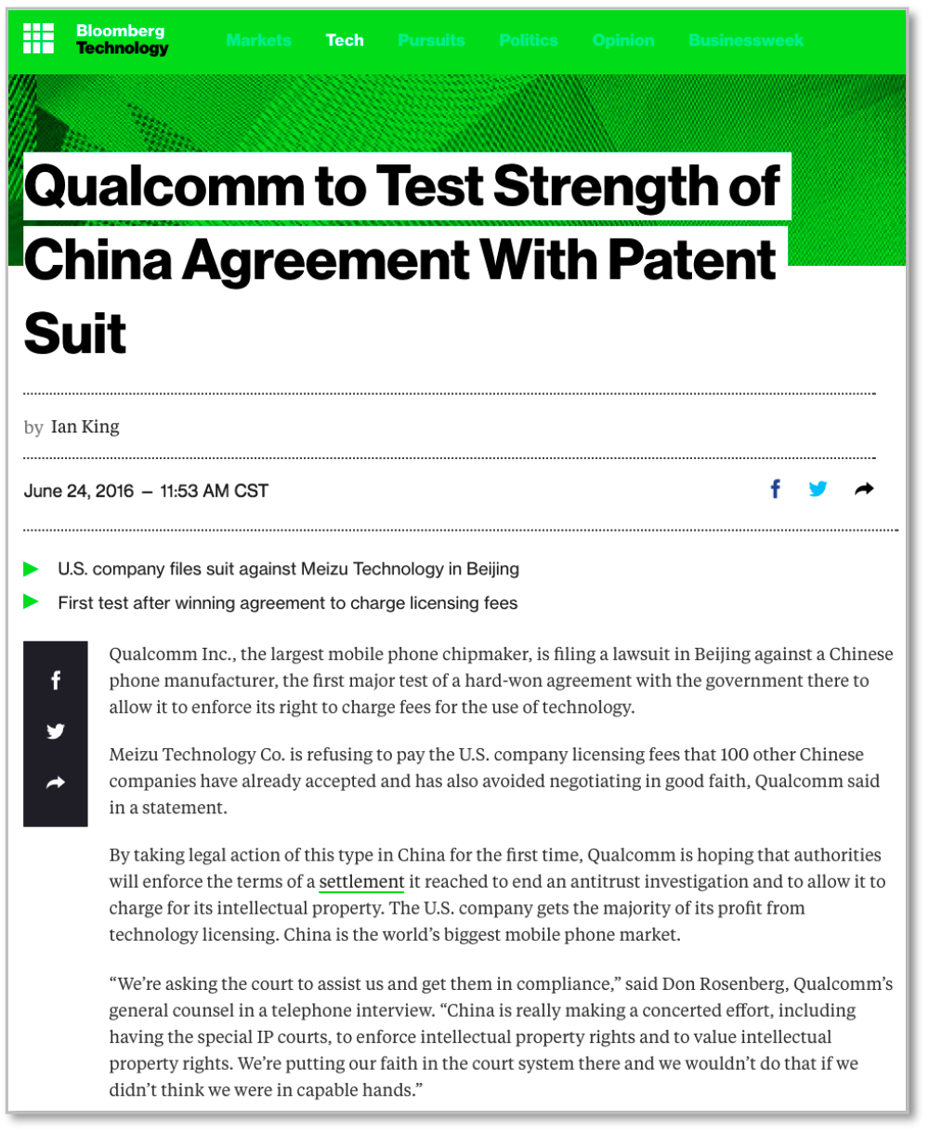
Qualcomm Is Using China For Enforcement
“We’re asking the court to assist us and get them in compliance,” said Don Rosenberg, Qualcomm’s general counsel in a telephone interview. “China is really making a concerted effort, including having the special IP courts, to enforce intellectual property rights and to value intellectual property rights. We’re putting our faith in the court system there and we wouldn’t do that if we didn’t think we were in capable hands.”
http://www.bloomberg.com/news/articles/2016-06-24/qualcomm-to-test-strength-of-china-agreement-with-patent-suit

Slide 7
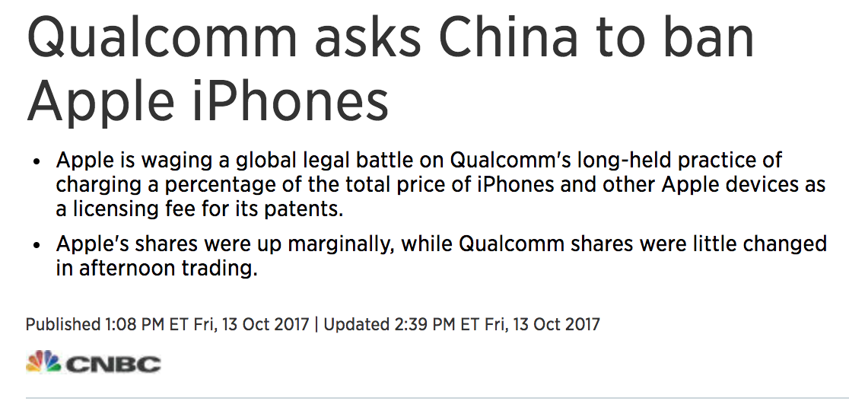
Qualcomm Is Using China For Enforcement
https://www.cnbc.com/2017/10/13/reuters-america-qualcomm-files-lawsuits-in-china-to-ban-iphones--bloomberg.html

Slide 8
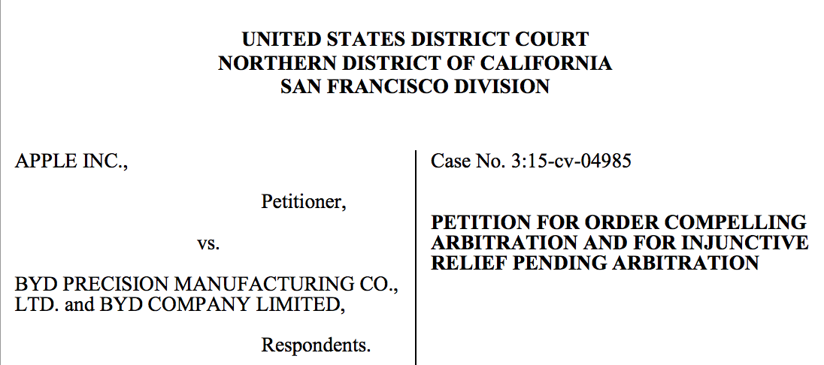
Apple Understands the Danger of China As A Patent Venue

Slide 9
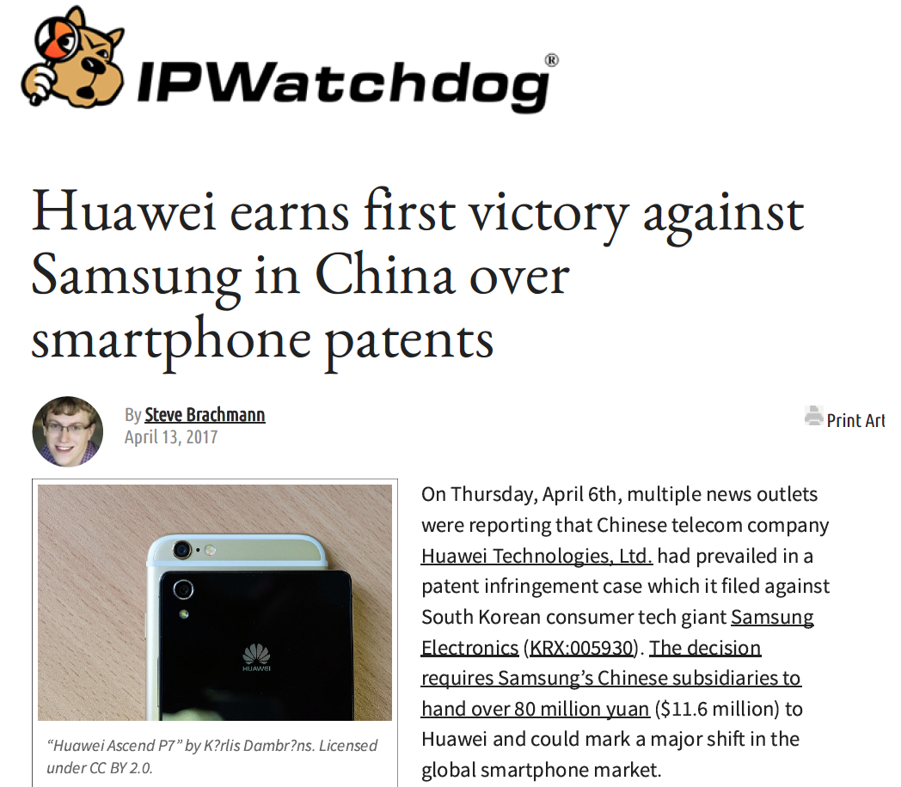
China Is Granting Injunctions
$11.6M
Plus
Injunction
http://www.ipwatchdog.com/2017/04/13/huawei-earns-first-victory-against-samsung-china-smartphone-patents/id=81871/

Slide 10
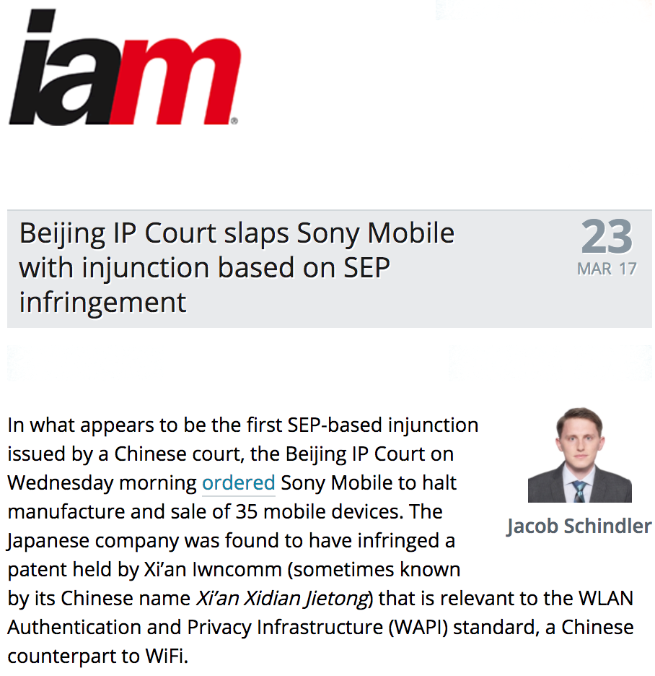
China Is Granting Injunctions in SEP cases, too!
First Injunction in an SEP case in China
$1.3 million in damages
Plus
$69k in expenses/fees
Plus
Permanent Injunction
http://www.iam-media.com/blog/detail.aspx?g=f0c6f49d-487a-4e2a-9fd8-e0ebf5e3c052

Slide 11
SEPs: IWNCOMM v. Sony
The court reasoned that even if the disputed patent is a SEP it does not affect the determination of whether there is a patent infringement. Thus, any unauthorized use of a patent, such as in this case, is subject to a determination of patent infringement.
The court reasoned that a patentee’s commitment to a FRAND statement is not equal to a valid licensing agreement.
In determining whether an injunction should be applied as a remedy if the dispute involves a SEP, the court reasoned that such determination should be based on mutual beneficial agreement, and whether there were faults made during the negotiation of the agreement. Specifically, where neither party is at fault, or the patentee is at fault and the implementer is not, the patentee’s request for an injunction shall be denied. Where the patentee is not at fault, but the implementer is at fault, the patentee’s request for an injunction shall be granted.
The court awarded treble damages of RMB 8,629,173 plus expenses of RMB 474,194, including attorneys’ fees of RMB 400,000

Slide 12
Damages Are Increasing
On 22 March 2016, the China Supreme People’s Court released its latest Interpretations on Certain Issues Concerning the Application of Law in the Trial of Patent Infringement Cases (II) (the "New Interpretations"). They took effect on April 1.
Shifting of Burden for Proving Damages to the Accused Infringer Article 27 shifts the burden of proof from the patentee to the accused infringer when proof of damages is difficult to obtain except through receiving information from the defendant. Specifically, in instances when the patentee has reasonably attempted to fulfill the burden of proof and evidentiary standards required but meaningful evidence is possessed only by the accused infringer, the court may require the defendant to submit damages evidence. If the accused infringer refuses to provide such account books and materials without justification or provides false account books and materials, the people’s court may determine damages based on the reasonably supported claims of the patent holder.
http://www.ebeijing.gov.cn/BeijingInformation/BeijingNewsUpdate/t1461670.htm

Slide 13
Damages Are Increasing
The Beijing IP Court on 8 Dec 2016 awarded damages of 50,000,000 RMB ($7.3M) in a patent case. This included 49 million RMB in civil compensation plus 1 million RMB in legal fees. This is one of the first instances of a court awarding legal fees to a prevailing party based on the time spent on the matter.
This is one of the first cases after the new burden-shifting rules for damages. Thus, damages were not limited to statutory damages. This is the beginning of a new phase in patent damages in China.
Chinese v. Chinese
Relatively small case
Technology related to USB security
Largest damages by that court
One of first cases after damages burden-shifting rule
Chen Jinchuan, deputy director of the court, stated, "The market is the best frame of reference to determine the value of IPs," he said.
http://www.ebeijing.gov.cn/BeijingInformation/BeijingNewsUpdate/t1461670.htm

Slide 14
Litigation Timeline
Plaintiff files civil complaint
Evidence submission and exchange
Court accepts complaint
When an appeal is filed by the defendant, the injunction is normally stayed.
Court initiates service of complaint
“Preliminary” Injunction
Judgment
For maximum leverage, a “preliminary” injunction request can be filed or renewed after winning at first instance (trial court). Because the patentee has already shown infringement, this PI request will likely be granted.
Defendant files response
Appeal filed (stays injunction)
Court serves response on plaintiff
Court hearing
Injunction
7
5
However, a bond must be posted by the patentee before the PI is enforced (no bond is required if the defendant does not appeal or the defendant loses the appeal).
< 30 days
1 – 4 months
1 – 4 months
1 – 3 months
< 30 days
1 | 2 | 3 | 4 | 5 | 6 | 7 | 8 | 9 | 10 | 11 | 12 | 13 | 14
MONTH
Defendant files invalidity action at Patent review board (patent litigation rarely stayed) (pendency 1 - 2.5 years)
Defendant can file challenge to jurisdiction (to be decided within 45 days by statute)
Filing to judgment in just over a year
(Appeal is additional 6-12 months)

Slide 15
Bond Calculation for Preliminary Injunction
The amount of bond required is generally inconsistent across courts and judges, and no statistics are available.
Only consistency is that the amount is much less than the amounts required in Germany.
The local courts generally use the same standards, and the applicant must provide bond equal to the amount of damages claimed.
According to Beijing higher court‘s provisions, where the applicant cannot provide the bond equal to the amount claimed, if the parties' rights and responsibilities are clear and irreparable damage will occur, the court may require 20% of the amount claimed.

Slide 16
The Evolving Chinese Semiconductor Market: How Patents Will Matter
The Chinese government has decided to rid the market of at least 65% of foreign companies in the Chinese semiconductor market by 2020.
It will do so via:
Buying foreign expertise (via joint partnerships)
Financial incentives and support for domestic companies
Use of the Anti-Monopoly Law through the three Chinese agencies:
Ministry of Commerce (MOFCOM): responsible for reviewing M&A transactions and other types of proposed business concentrations.
National Development and Reform Commission (NDRC): Via its Price Supervision and Antimonopoly Bureau, NDRC manages enforcement of price-related conduct, including investigations of pricing practices by companies, price-related aspects of monopoly agreements, and company abuse of dominant market position to set or control prices.
State Administration for Industry and Commerce (SAIC): Through its Antimonopoly and Anti-Unfair Competition Bureau, SAIC is in charge of investigating non-price-related monopolistic behavior, including monopoly agreements, abuse of market dominance, and monopoly control.
Patent enforcement via Chinese operating companies and foreign NPEs

Slide 17
NPEs Can Also Be a Friend to China
NPEs are uniquely positioned to help China by attacking foreign entities to clear the way for Chinese companies by exerting pressure in ways that only NPEs can.
Even if Chinese semiconductor companies had the necessary patents and experience to engage their foreign competitors, they would risk retaliation from these foreign parties.
NPEs, on the other hand, can unilaterally attack foreigners without fear of retaliatory patent suits.
By putting pressure on foreign enterprises, such licensing companies can assist Chinese businesses in gaining greater market share at home and abroad.
NPEs can also work directly with Chinese companies and universities to provide needed expertise and experience in patent strategy as well as monetize their patents

Slide 18
NPEs Can Also Be a Friend to China
NPEs can also provide a portion of profits for engineering universities and students to educate the next generation of Chinese innovators not only about technology, but how patents and other IP can be used effectively for China and for themselves.
Indeed, by being a good “friend of China” NPEs will be exactly what China needs: an agent to help enact the goal of China to dominate its domestic industries in semiconductors and other fields.
Many of the goals of the Chinese government regarding elevating innovation and growing the domestic market can likely only be achieved, or achieved in a short time, with the direct assistance of foreign NPEs.
Although there are a few of antitrust issues, I do not believe that NPEs that act in the best interest of China should, or will, be attacked by the NDRC or any other antitrust agency in China.

Slide 19
How to Avoid Problems: Be a Friend to China
Always be a friend to China
The people. The industry. The government. This must be an overarching concern in any major decision. The path to success is to create a win-win for China. That means making sure that the Chinese people, their businesses, and their government benefit. I am NOT talking about corruption of any kind. Rather, I am talking about making sure that anything negative that is created is countered by a positive.
Growth sometimes means bad things for Chinese companies and people in the short run. However, there must some “good” to equal the “bad” – at least in the long run (in China, the “long” run might be only 1-2 years).
As the Chinese “Internet Czar” recently stated, to succeed in China, foreigners must “be a friend to China.” This could mean investing in Chinese tech startups, setting up technology incubators, working with universities, or anything that gives back to China. Contributions can be financial, or strategic, by providing much-needed advice on how to manage and leverage IP. China now has the minds and the money, but still lacks experience in semiconductors. By building relationships with companies and schools that will foster the next stage of innovation in China, foreign companies can help China get to where it wants to be: an innovation-driven economy.
The best way is to create a “win-win” partnership with Chinese companies.

Slide 20
How Foreign Companies Can Be a Friend to China: An Example
Intel bought a 20% stake in Tsinghua Unigroup a little over two years ago.
I have regularly called this move by Intel likely the best strategic move by an American company in China ever.
Why? Other than the obvious, it
Instantly made Intel a Chinese company (in part -- a very political part) and
Gave Intel a remarkably direct conduit to the Chinese government.
This latter point cannot be underestimated, as it should allow Intel to hear about any political or competitive problems much earlier.
The affiliated Tsinghua University is not just one of (if not the) top university in China, but it is very politically connected. For example, it is the alma mater of President Xi Jinping.

Slide 21
Why Chinese IP Enforcement is Good for U.S. Companies
Other than TIER….
US companies can protect their IP
Contract enforcement is also very good
Keep it simple
Like the strike zone in baseball
All major problems may not be fair, but were predictable

Slide 22
THANK YOU!
Erick.Robinson@BeijingEastIP.com
www.beijingeastip.com

